Slide 1

International Schools in the U.S.
How emerging wealth, policy, schools and university performance supported rapid expansion of International Schools abroad and it’s extension into key U.S. markets
15-Dec-2017
Kristine Adzema, Naga Pulivarthi, Sumana, Craig Bauer

Slide 2
Executive Summary
International schools, which were established more than 3 decades ago, have expanded in numbers and students enrollment 5.5x the rate of global population growth
Originally formed to serve EU, UK and U.S. ex-patriots abroad, these English medium schools provided curricula aligned for top-tier western university admission
The growth has stemmed from globalization, policy changes but more commonly local and native families you can now afford these schools for their children in emerging markets
While the U.S. continues to dominate Top global universities destinations, it’s global K12 performance has slid below many of these emerging markets
An examination over a period from CY2000-2016, illustrates a growth and a ‘path’ in international students in U.S. universities extending to immigration and changes in race and minority household income growth in the same and neighboring communities
The analysis further illustrates an expansion of International Schools in the same U.S. markets
Source: ISC Research and World Population by Year, WorldBank

Slide 3
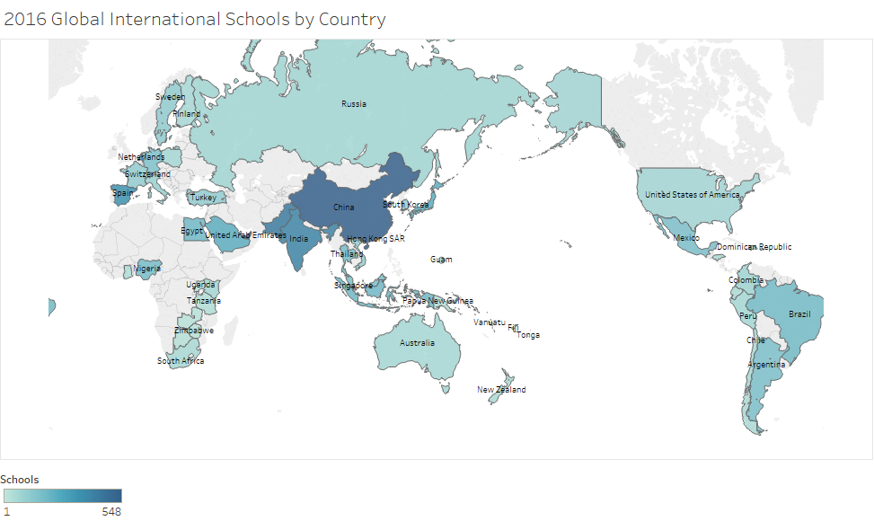
Expansion of K12 International Schools
Thirty years ago, there were less than 1,000 international schools. By the year 2000, there were 2,500 schools and by 2016, there are more than 8,200 schools with 4.3 million students enrolled.
Source: ISC Research

Slide 4
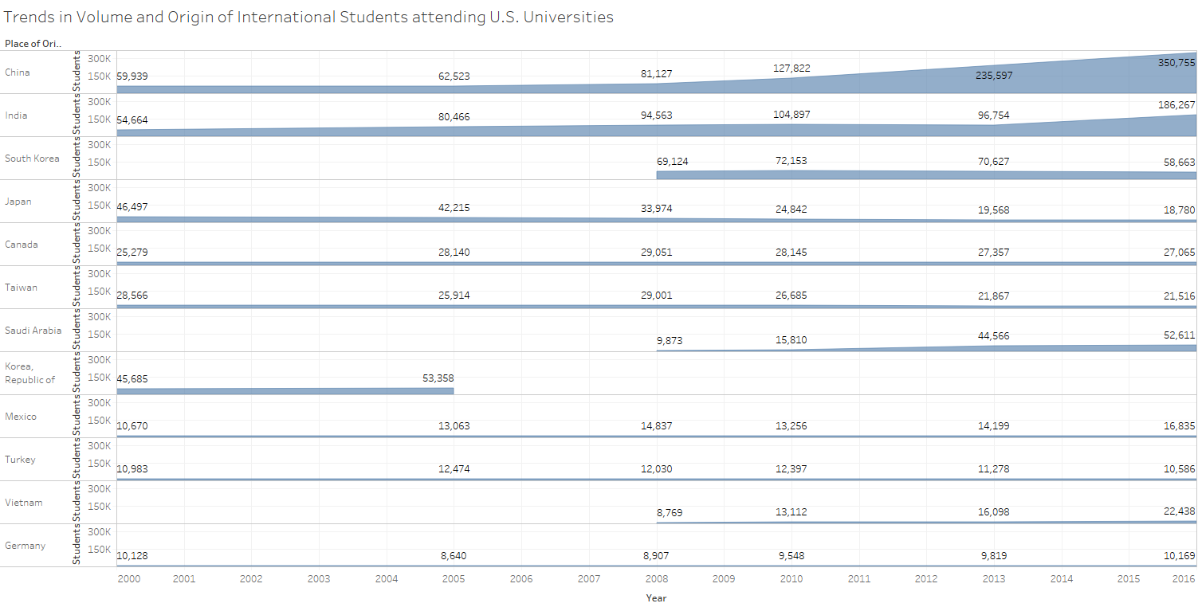
Trends in Volume and Origin of International Students attending U.S. Universities
Top country origins align with leading growth markets for International Schools
Source: IIE

Slide 5
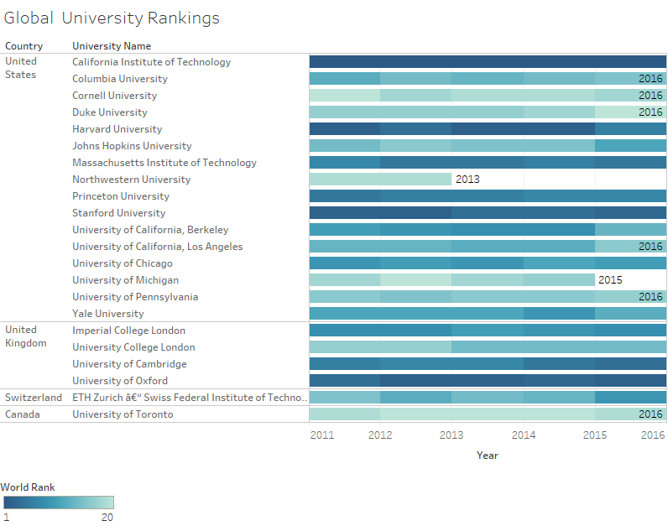
Rankings of Top Global Higher Education Universities
U.S. continues to lead top-20 global university rankings
Source: IIE

Slide 6
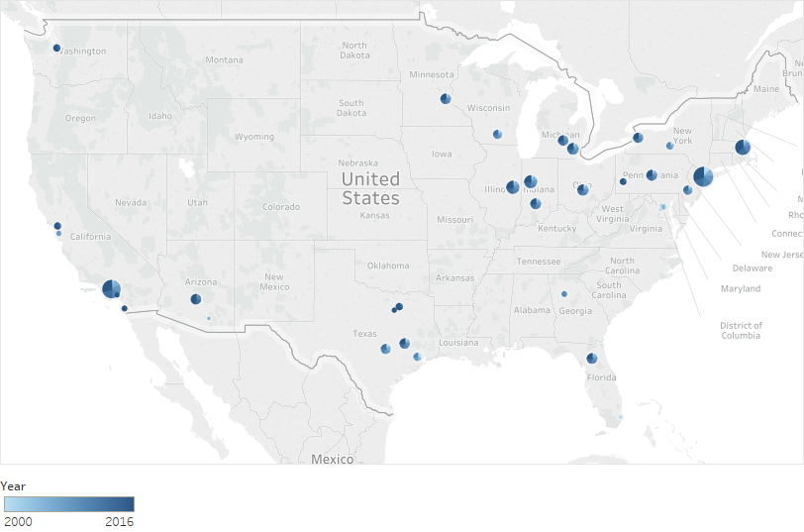
Growth of International Students University Destinations
The leading city and county destinations of international university students
Source: IIE

Slide 7
Trends in minority household composition by county/city
Source: 2000-2016 Census

Slide 8
Trends in minority household income composition by county/city
Source: 2000-2016 Census

Slide 9
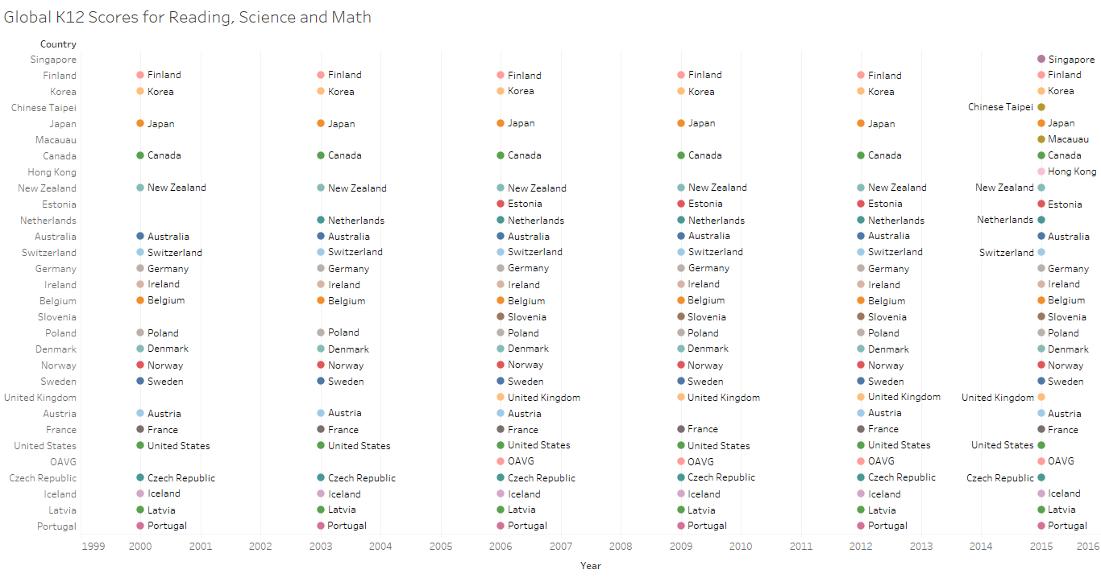
Rankings of Top Global K12 School Scores
2015, the US ranking fell to 35th from 28th in math and to 24th in science and Reading
Source: Organization for Economic Co-operation and Development (OECD) global rankings on student performance in mathematics, reading, and science, on the Program for International Student Assessment, or PISA.

Slide 10
U.S. School Policy changes from 2000-2016

Slide 11
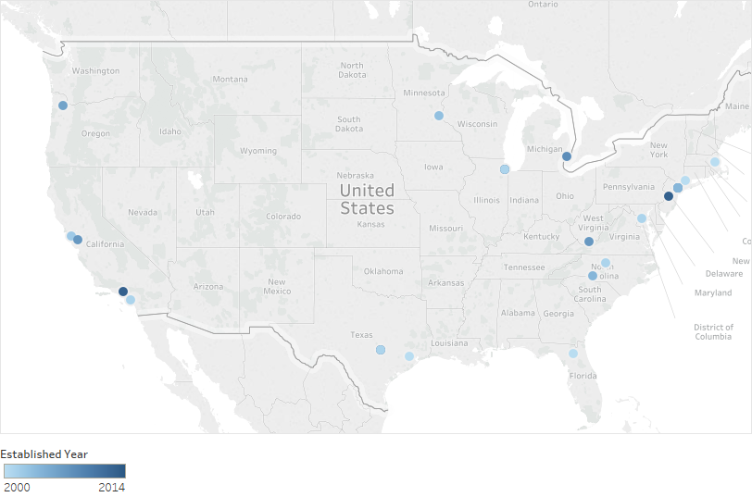
Expansion of International Schools in the U.S. by county/city
Since CY 2000, 28 International Schools were added in these U.S. markets extending the total to 73 schools
Source: Wikipedia

Slide 12








Technology

